Slide 1

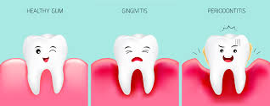
GINGIVAL INFLAMMATION
RUNGTA COLLEGE OF DENTAL SCIENCES AND RESEARCH,BHILAI
DR. PUSHPENDRA YADAV
sr. lecturer
DEPT. OF PERIODONTOLOGY

Slide 2
SPECIFIC LEARNING OBJECTIVES
CORE AREAS | DOMAIN | CATEGORY
Introduction | Affective | Desire to know
Classification | Cognitive | Must to know
Stages of Gingivitis | Cognitive | Must to know
Stage I: The Initial Lesion • Stage II: The Early Lesion | Cognitive | Must to know
Stage III: The Established Lesion • Stage IV: Advanced Lesion | Cognitive | Must to know

Slide 3
content
Introduction
Classification
Stages of Gingivitis
• Stage I: The Initial Lesion
• Stage II: The Early Lesion
• Stage III: The Established Lesion
• Stage IV: Advanced Lesion

Slide 4
Introduction
Inflammation of gingiva is called gingivitis. Most forms of periodontal diseases are plaque-associated disorders which start as an overt inflammation of the gingiva. In susceptible individuals, if inflammation is left untreated it may spread to involve deeper portions of the periodontium.

Slide 5
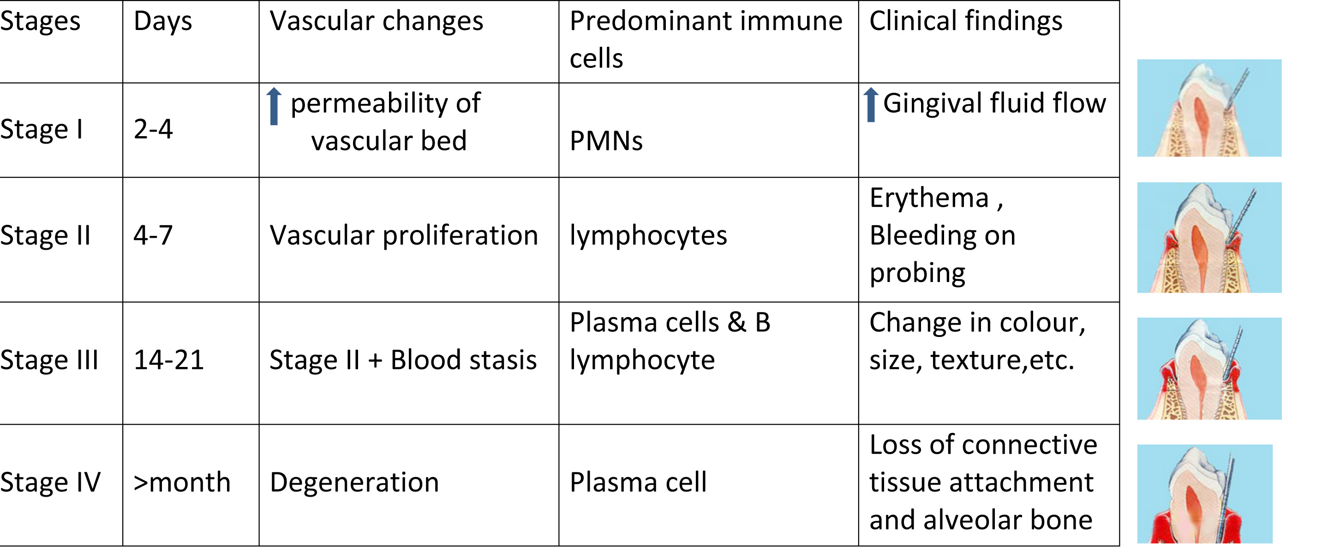

Slide 6
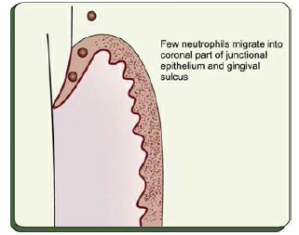
PRISTINE GINGIVA

Slide 7
STAGE I GINGIVITIS: THE INITIAL LESION
vascular changes
dilated capillaries and increased blood flow.
occur in response to microbial activation of resident leukocytes and the subsequent stimulation of endothelialcells.
Clinically, this initial response of the gingiva to bacterial plaque (subclinical gingivitis) is not apparent

Slide 8
Microscopically
Signs of acute inflammation seen in the connective tissue beneath the junctional epithelium.
Changes in blood vessel morphologic features (e.g., widening of small capillaries or venules)
Adherence of neutrophils to vessel walls (margination) occur within 1 week and sometimes as early as 2 days after plaque accumulation.
Leukocytes, mainly PMNs, leave the capillaries by migrating through the walls (diapedesis, emigration)

Slide 9
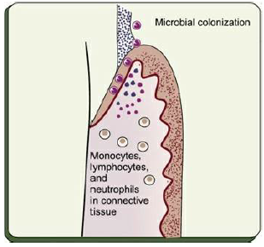

Slide 10
STAGE II GINGIVITIS: THE EARLY LESION
The early lesion evolves from the initial lesion within about 1 week after the beginning of plaque accumulation.
Clinically, no clear-cut dividing line.
As time goes on, clinical signs of erythema may appear,
  proliferation of capillaries and
  increased formation of capillary loops between rete pegs or ridges

Slide 11
Bleeding on probing
Between 6 and 12 days .... Increased Gingival fluid flow and transmigrating leukocytes

Slide 12
Microscopically
Gingiva reveals leukocyte infiltration in the connective tissue beneath the junctional epithelium,
consisting mainly of lymphocytes (75%, with the majority T cells), but also composed of some migrating neutrophils, as well as macrophages, plasma cells, and mast cells.

Slide 13
All the changes seen in the initial lesion continue to intensify with the early lesion.
The junctional epithelium:
  densely infiltrated with neutrophils,
  development of rete pegs or ridges.

Slide 14
70% collagen is destroyed around the cellular infiltrate.
The main fiber groups affected
  circular and dentogingival fiber assemblies

Slide 15
Polymorphonuclear leukocytes (PMNs)
leaves the blood vessels
cross the basement lamina,
found in the epithelium, emerging in the pocket area.
PMNs engulf bacteria in the process of phagocytosis.
Fibroblasts show cytotoxic alterations, with a decreased capacity for collagen production

Slide 16
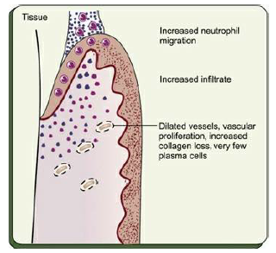

Slide 17
STAGE III GINGIVITIS: THE ESTABLISHED LESION
predominance of plasma cells and B lymphocytes (IgG1 and IgG3) subclasses and probably in conjunction with the creation of a small gingival pocket lined with a pocket epithelium.

Slide 18
In chronic gingivitis, which occurs 2 to 3 weeks after the beginning of plaque accumulation,
the blood vessels become engorged and congested, venous return is impaired, and the blood flow becomes sluggish.
The result is localized gingival anoxemia, which superimposes a somewhat bluish hue on the reddened gingiva

Slide 19
Extravasation of erythrocytes into the connective tissue and breakdown of hemoglobin into its component pigments can also deepen the color of the chronically inflamed gingiva.
described as moderately to severely inflamed gingiva

Slide 20
Histologically
increased number of plasma cells- preponderant inflammatory cell type.
Plasma cells invade deeply into the connective tissue, around blood vessels, and between bundles of collagen fibers

Slide 21
The junctional epithelium reveals widened intercellular spaces filled with granular cellular debris, including lysosomes derived from disrupted neutrophils, lymphocytes, and monocytes.
The lysosomes contain acid hydrolases that can destroy tissue components.

Slide 22
The junctional epithelium develops rete pegs or ridges that protrude into the connective tissue, and the basal lamina is destroyed in some areas.
In the connective tissue, collagen fibers are destroyed around the infiltrate of intact and disrupted plasma cells, neutrophils, lymphocytes, monocytes, and mast cells

Slide 23
An inverse relationship appears to exist between the number of intact collagen bundles and the number of inflammatory cells.
Collagenolytic activity is increased in inflamed gingival tissue by the enzyme collagenase.
Collagenase is normally present in gingival tissues and is produced by some oral bacteria and by PMNs

Slide 24
Enzyme histochemistry studies have shown that chronically inflamed gingivae have elevated levels of acid and alkaline phosphatase, β-glucuronidase, β-glucosidase, β-galactosidase, esterases, aminopeptidase and cytochrome oxidase.
Neutral mucopolysaccharide levels are decreased, presumably as a result of degradation of the ground substance

Slide 25
Established lesions of two types and appear to be reversible;
  some remain stable and do not progress for months or years, and
  others seem to become more active and to convert to progressively destructive lesions.

Slide 26
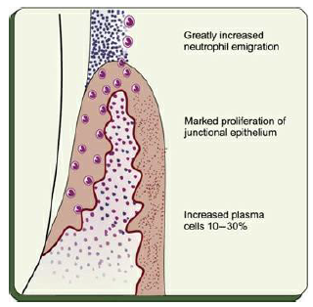

Slide 27
STAGE IV GINGIVITIS: THE ADVANCED LESION
Extension of the lesion into alveolar bone characterizes a fourth stage known as the advanced lesion or phase of periodontal breakdown

Slide 28
Microscopically
there is fibrosis of the gingiva
widespread manifestations of inflammatory and immunopathologic tissue damage.
plasma cells continue to dominate the connective tissues, and neutrophils continue to dominate the junctional epithelium and gingival crevice

Slide 29
summary
Gingival conditions/diseases that mainly involve
interdental papilla and gingival margin are gingival
abscess, necrotizing ulcerative gingivitis, linear
gingival erythema and drug induced gingival
enlargement.
Gingival ulcers are usually seen in NUG, herpes
simplex virus stomatitis, aphthae, self-injury,
malignant neoplasms, drugs, dermatoses, systemic
diseases (hematological disorders, tuberculosis,
syphilis, herpes virus, HIV).

Slide 30
REFERENCE
Newman MG, Takei HH, Klokkevold PR, Carranza FA. Carranza’s clinical periodontology, 10th ed. Saunders Elsevier; 2007.
Lindhe J, Lang NP and Karring T. Clinical Periodontology and Implant Dentistry. 6th ed. Oxford (UK): Blackwell Publishing Ltd.; 2015.
Newman MG, Takei HH, Klokkevold PR, Carranza FA. Carranza’s clinical periodontology, 13th ed. Saunders Elsevier; 2018.

Slide 31
THANK YOU

